Slide 1
Management of Lets Pricing and Availability
Redesign Board
17 October 2017

Slide 2
Management of Lets
Improve booking process (Lean)
Rationalise schools available for lets
Review pricing
Grow the business

Slide 3
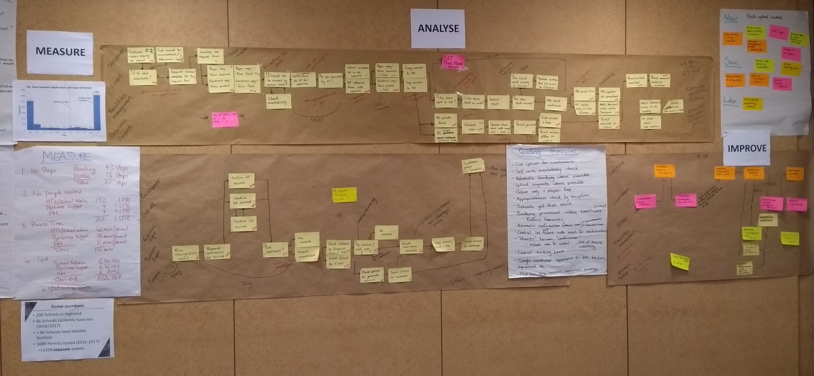
Booking Process - Lean

Slide 4
Booking Process - Lean
61 steps to 8
Reduce people involved and process time
Central function – consistent, efficient
Short term improvements
Automatic booking
For “letting schools” instant decision
Upfront payment
IT solution (inc. VFM check)

Slide 5
Service Improvements
Create central booking function
Develop comprehensive guidance/ criteria
Changing and floodlighting
Replace MUGA with pro rata all weather pitch
Review all weather pitch prices (Sportscotland)
Band A meeting room → per hour rate
Remove weekend surcharge (25%)
Introduce exclusive use rate/ cap
Introduce POA rate for significant events
Review Terms and Conditions.

Slide 6
Rationalise Premises
Efficient use of buildings and staff
Selection criteria: facilities available/ how busy/ PPP2/ local facilities
Serviced schools – support booking process
Pre-booked school events (schools open for lets)
All schools – after schools and evening events
ASG by ASG approach; HT involvement
Inverness, Nairn, Thurso, Fortrose, Invergordon
Culloden ASG pilot

Slide 7
Commercial Approaches
Subsidised service supports community activity - facilities available at minimal cost
Cover costs and generate surplus for investment in service and facilities
Competitive pricing in market place
A profit maximisation approach that charges the maximum the market will bear and only opens profitable facilities
A demand based approach that uses dynamic/ differential pricing to maximise income from high demand facilities.

Slide 8
Saving – Income Target
Potential stumbling block to progress
Outstanding gap £182K; of which £150K free lets
Temporary solution in place for 17/18 but risk for future years
Free lets target based on incorrect assumptions
£150K challenging to achieve:
Substantial price rises
Self defeating?
Recognition failure to fill gap transfers pressure elsewhere

Slide 9
Free Lets
School activities defined
Uniformed groups
Community Councils
Feisean/ Mods
Historic arrangements
Est. £40K lost income (reliability?)
Politically sensitive – requires Member guidance and support

Slide 10
Options for Future Prices
1 – Lets in PPP/HLH only
2 – 2009 policy, amended + 5%pa →22/23
3 – 2009 policy, amended + 10%pa →22/23
4 – 2009 policy amended + 39% 18/19 then 10%pa → 22/23
Implications:
Staff
Budgets/ savings
Communities
Competitiveness/ potential to grow business

Slide 11
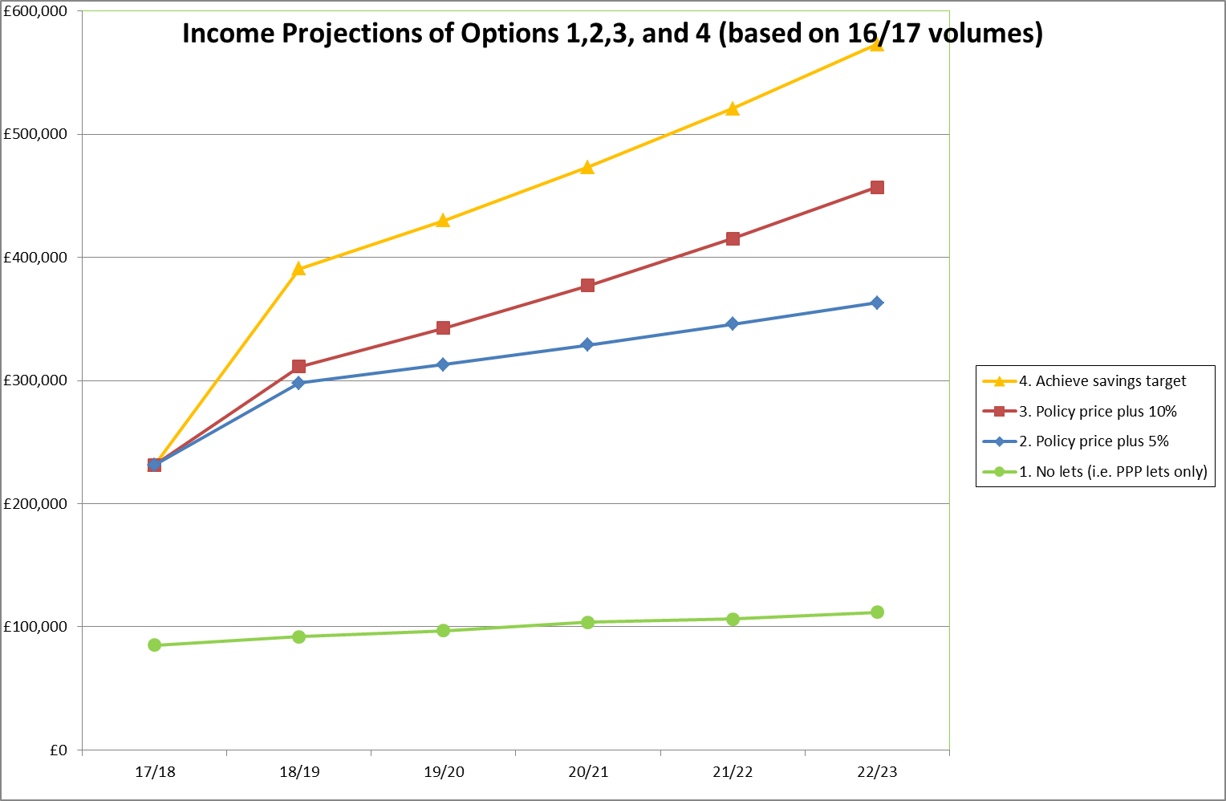
Options for Future Prices

Slide 12
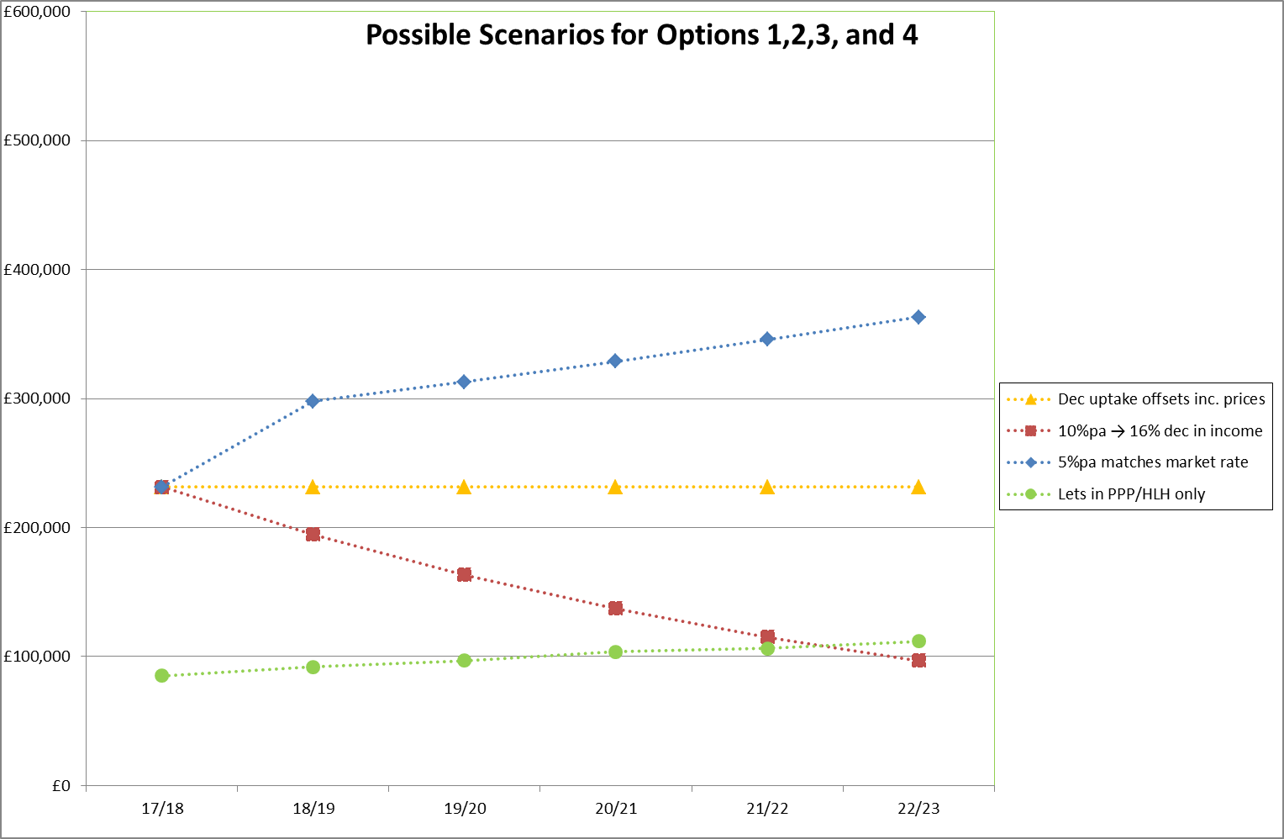
Options for Future Prices

Slide 13
Redesign Board
Discussion, suggestions and guidance:
Amendments to the pricing structure
The principle and process for rationalising schools available for lets
Free lets
Options for future pricing.
Identification of any additional issues or options to follow up.
Guidance on next steps for further analysis and/or whether proposals ready for Committee.

