Slide 1
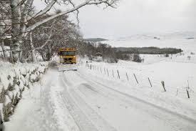
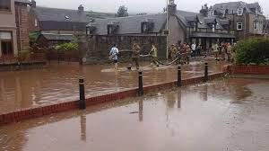
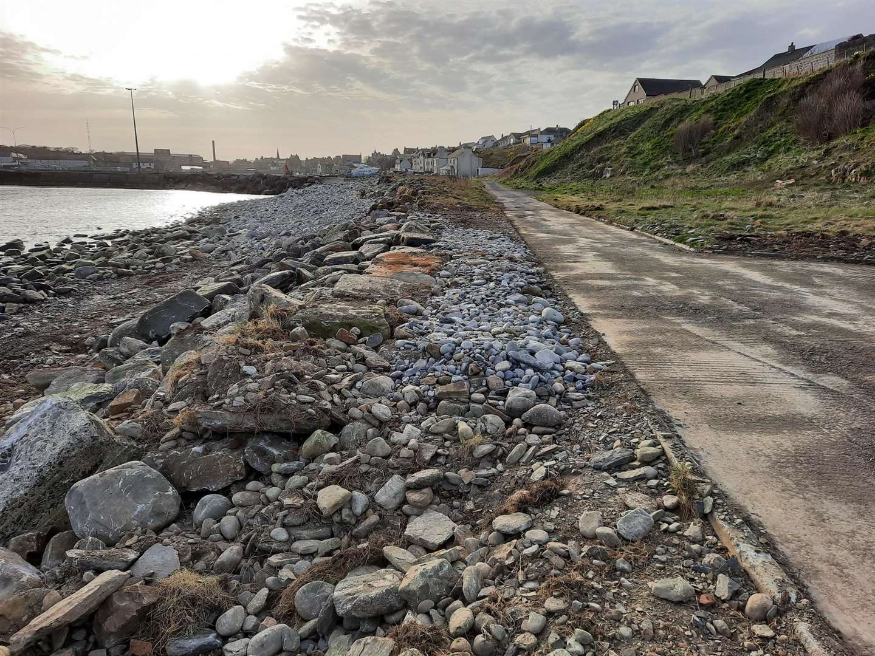
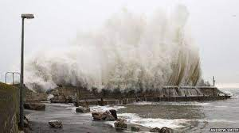
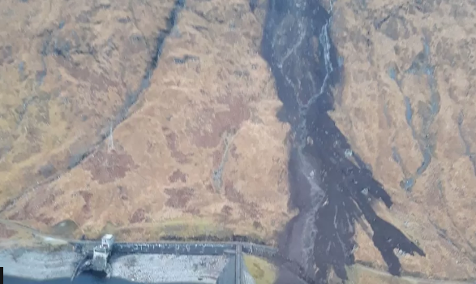
The Highland Council Climate Change Adaptation Katie Andrews

Slide 2
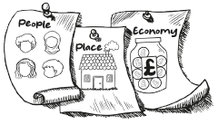
Overview
Setting the Scene – Organisational Context
Adaptation & The Highland Council
Capability Framework:
- Organisational Culture & Resources
- Understanding the Challenge
- Planning & Implementation
- Working Together
Case Studies – Climate Adaptation in The Highland Council

Slide 3
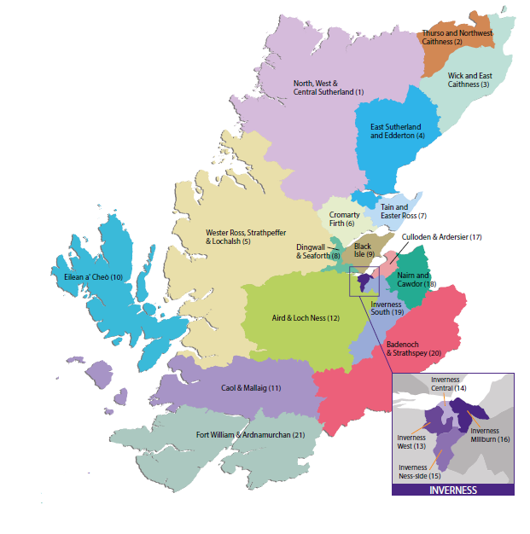
Background
The Highland Council is the largest local authority in UK, 33% of the land area of Scotland.
235,430 residents and thousands of annual visitors.
Sparsely populated, vast and diverse landscape.
The area includes 6 inhabited islands.
Over 4,900 km of coastline – 21% of the Scottish total.
The Council manages and maintains 6,771 km roads, 91 harbours and marine facilities, 199 schools and 14,880 council houses.

Slide 4
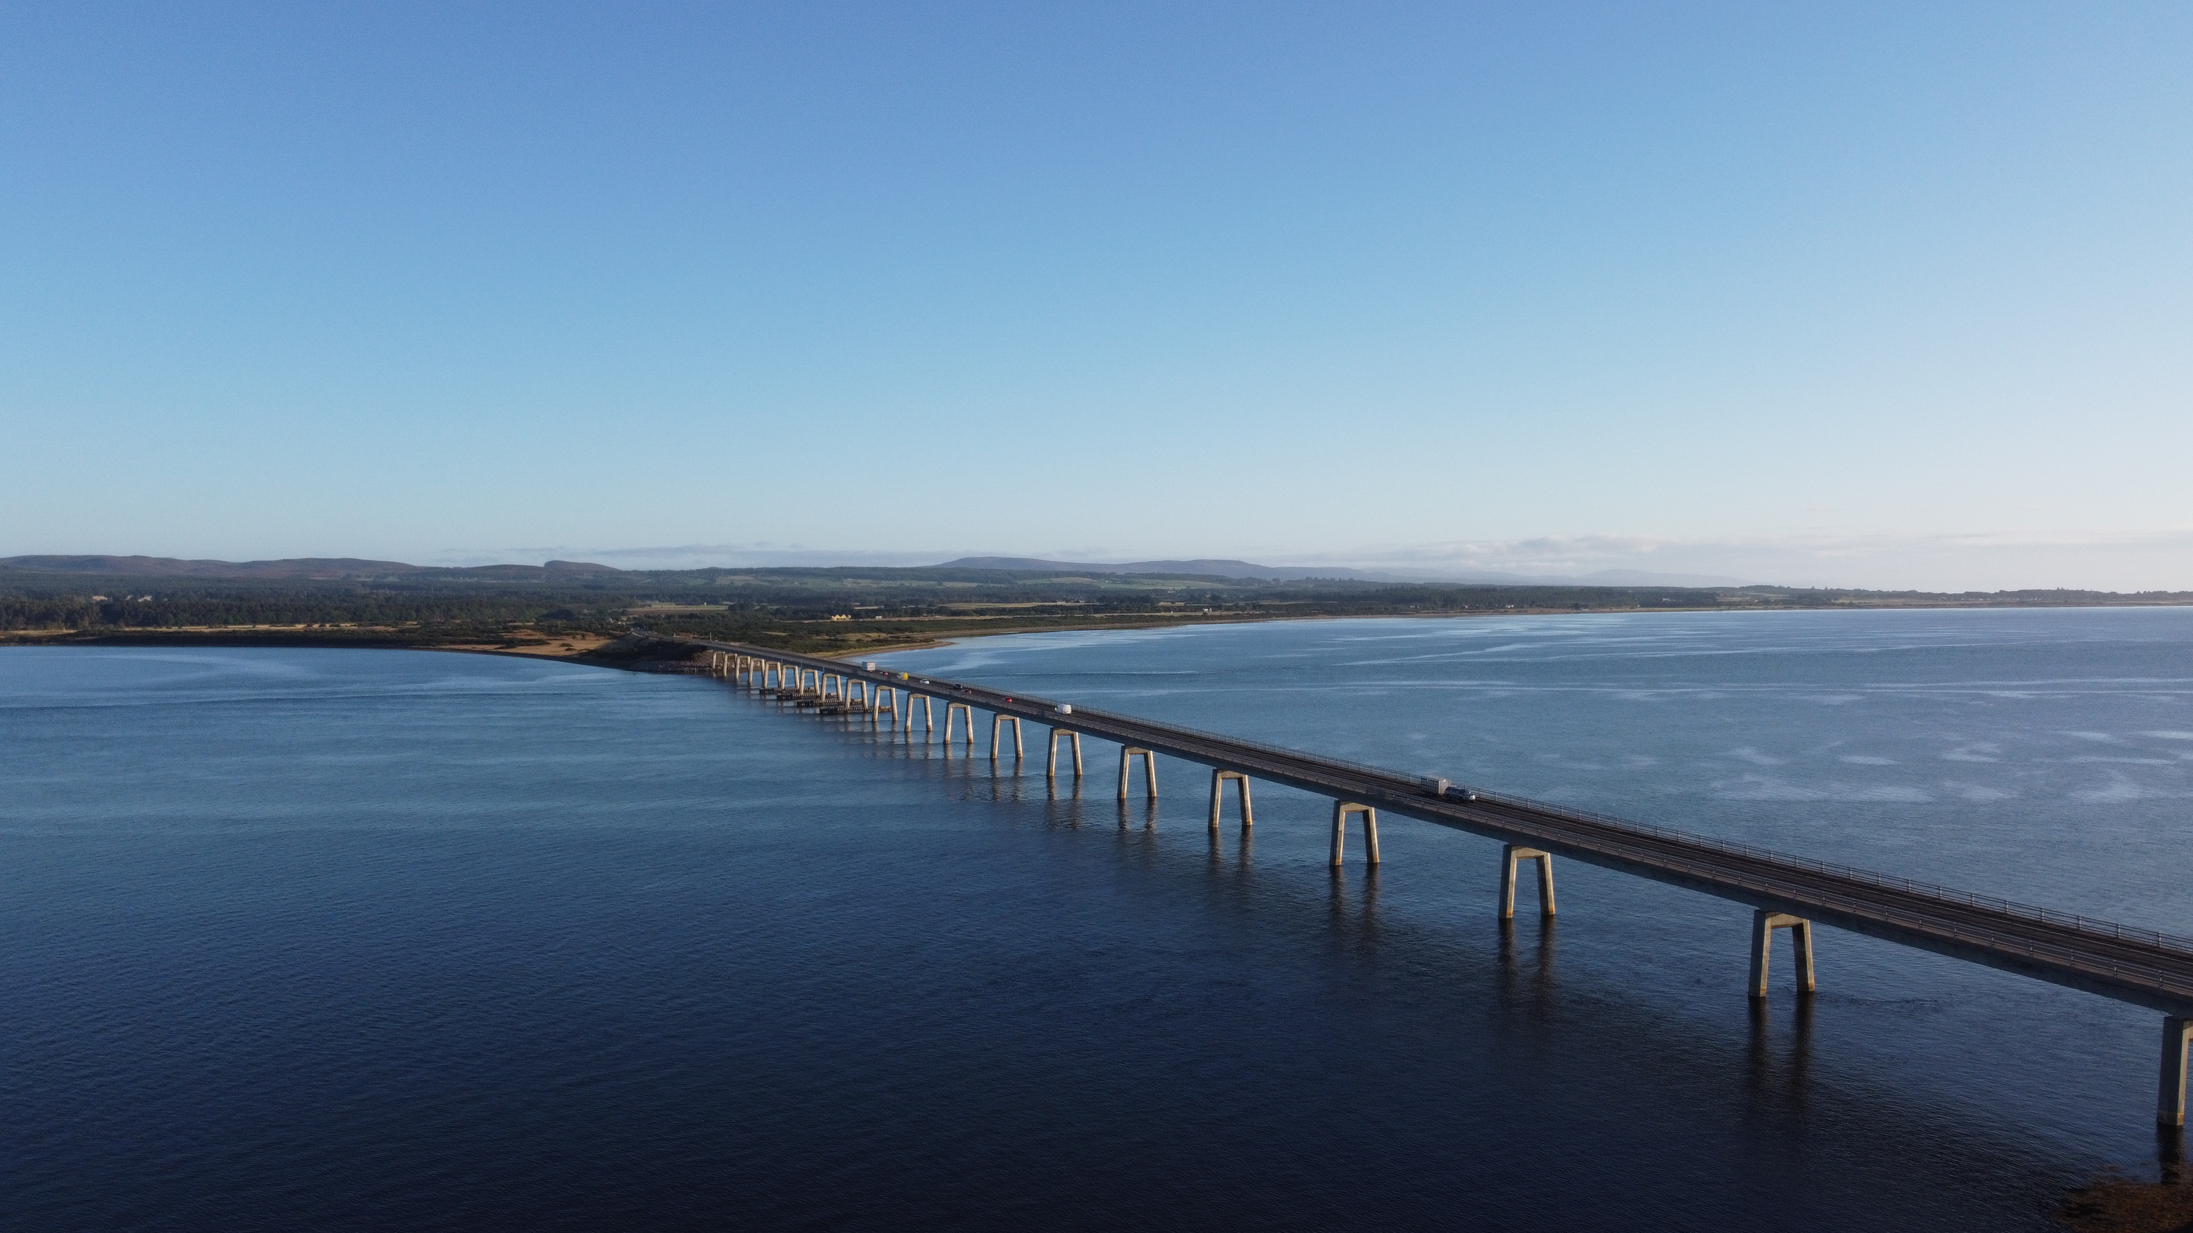
Adaptation & The Highland Council
Adapting to climate change will be necessary regardless of how much we manage to cut our emissions.
The Highland Council and its services will need to be climate resilient and ready.
Adaptation is a legal imperative for the Council and is supported by legislative and policy drivers.
Over 10,000 employees working across 8 key services
Notes:
Adapting to climate change
Climate change is here as mentioned in Anna and Emma’s presentations and we are feeling the effects of it more intensely. All public bodies need to be resilient to the future climate and to plan for business continuity in relation to the delivery of their functions and the services they deliver to the wider community’
Climate resilient
Climate justice and the just transition
Delivering co-benefits – undertaking an action which no only improves for example flooding but enhances wildlife, creates an environment where people can enjoy nature and improved mental and physical wellbeing.
Legislative and policy drivers
Number of acts including the Civil Continencies Act 2004, Flood Risk Management Act 2009, and climate change act 2009
Public Bodies Duties reporting – show how we are aligning with the outcomes from the SCCAP2 outcomes
Corporate Risk under Climate change and ecological emergency – mitigating action is to produce an adaptation strategy and action plan

Slide 5
Resources & Finance
Assess the financial impact of past weather to identify priority areas
Ensure the Council is a safe environment to work in, protecting the health and wellbeing of employees.
Property & Housing
Buildings are adapted to extreme heat, rainfall, adverse weather and water efficient.
Embed resilience into planning, design & construction
Increase awareness of climate impacts among tenants
Chief Executive
Deputy Chief Executive
Performance & Governance
Infrastructure, Environment & Economy
Health & Social Care
Education & Learning
Resources & Finance
Property & Housing
Community & Place
Community & Place
Operations & logistic – fleet & infrastructure is climate ready and staff training for travelling in adverse weather.
Waste operations – business continuity plans and communication.
Community support & engagement – building strong partnerships with our communities to ensure they are resilient.
Environmental health & amenities – grounds maintenance incorporates resilience, reduced cuts to promote biodiversity, water efficiency.
Education & Learning
Our educators understand how to keep pupils and themselves safe.
Ensure continuity in education when schools close.
Performance & Governance
Climate change – support with communications, data and policy guidance.
Corporate Comms – early warning systems. Resilience and Emergency Planners will support services with Business Continuity Plans
Corporate Risk – climate risk assessment for the Council.
Health & Social Care
Protect most vulnerable from climate change.
Continuity of service.
Frontline staff are kept safe with correct PPE.
Infrastructure, Environment & Economy
Infrastructure – adapt our infrastructure to ensure it is resilient to climate change
Planning – embedding resilience and updating planning policy.
Environment –investing in green networks, nature-based solutions, green/blue infrastructure.
Economic development & regeneration – ensuring our plans for regeneration are factoring in climate change.

Slide 6
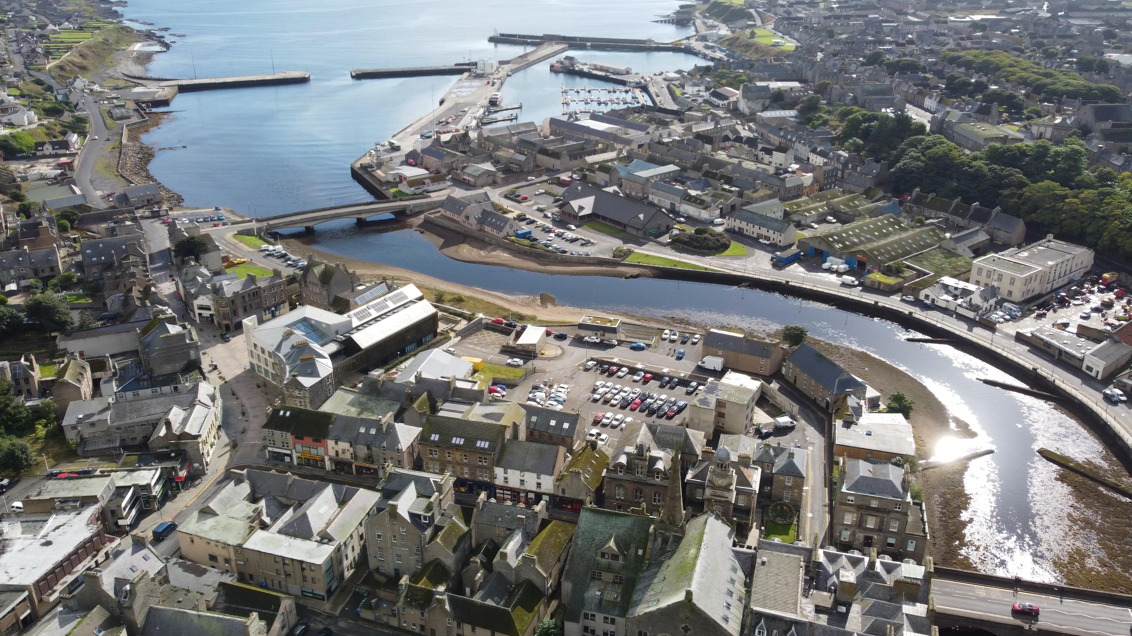
What do we need to do as a Council?
Align adaptation with the Council’s strategic outcomes and priorities e.g. ‘Our Future Highland’
Understand how the Council has been impacted by climate change and identify organisational climate risks and opportunities
Embed adaptation into procedures, policy and operations of the Council and set out a list of actions.
Continue to develop and strengthen partnership working.

Slide 7
Capability Framework
Organisational culture and resources – focussed on Council priorities, governance structures and resource availability;
Understanding the challenge – develops the robust evidence base on risk and vulnerability to inform Council decision-making;
Planning and implementation – aligns adaptation with Highland Council objectives, options appraisal, adaptation strategy development and delivery;
Working together – fosters networking and collaboration for joint adaptation action to achieve shared adaptation outcomes.

Slide 8
Organisational Culture & Resource

Slide 9
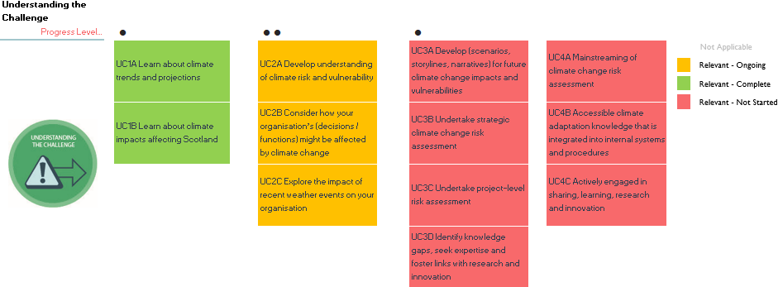
Understanding the Challenge

Slide 10
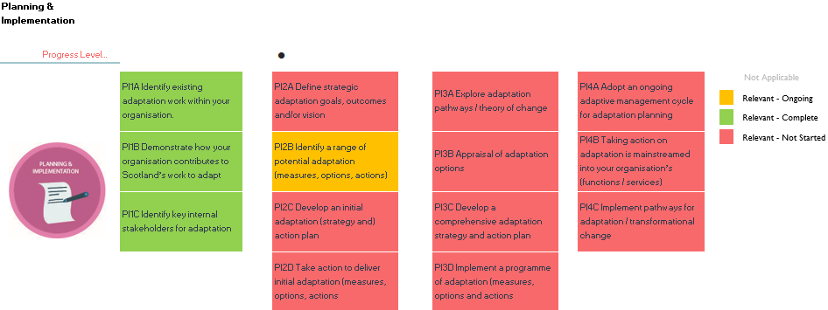
Planning & Implementation

Slide 11
Working Together

Slide 12
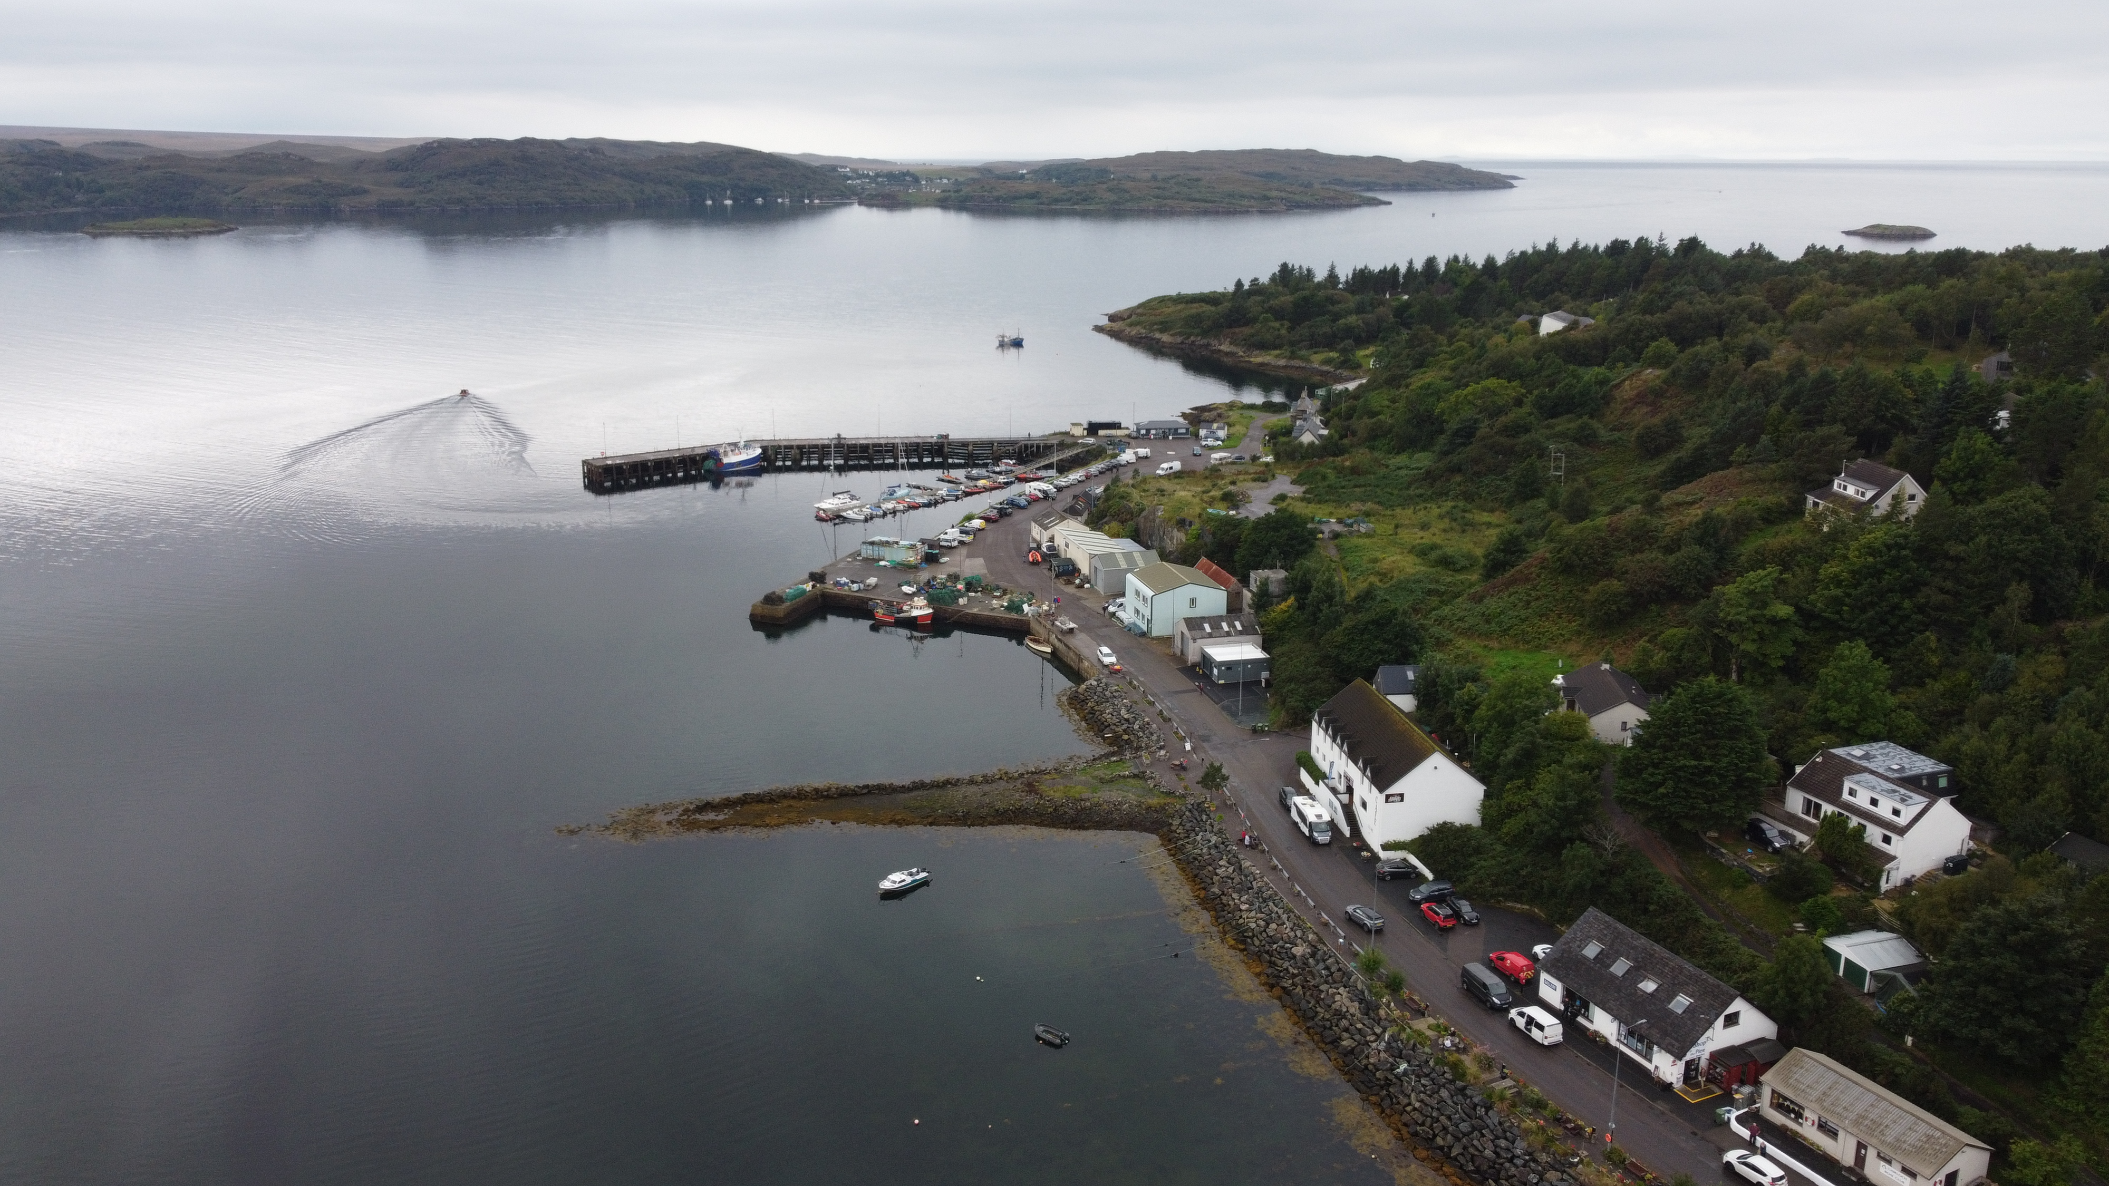
Next Steps & Future Actions
Organisational Culture & Resource:
Governance
Establish a network of ‘Adaptation Champions’ across the Council
Identify opportunities to incorporate adaptation in plans, policy, and procedure
Understanding the Challenge:
Produce an internal LCLIP to identify risks, vulnerabilities and opportunities;
Develop plans to conduct a Council climate risk and opportunity assessment.
Planning & Implementing:
Define goals, outcomes and a vision for adaptation
Develop an adaptation strategy and action plan
Working Together:
Develop and strengthen partnership working
Develop communication and engagement activities with partners.
Coordinate adaptation actions with partners

Slide 13
Case Studies: Climate Adaptation & Resilience in The Highland Council

